Slide 1
Covid - Death VS Vaccination

Slide 2
Motivation
The motivation behind our project was to assess the impact of vaccination rates on death rates, moving from a localized focus on the United States to a global scale. Understanding the correlation between vaccination and mortality rates worldwide is critical in the fight against the COVID-19 pandemic
The primary problem was two-fold: first, to expand the analysis from U.S.-based data to a global context, and second, to determine the relationship between vaccination rates and death rates across the globe.
It is crucial to assess the global correlation between vaccination and mortality rates to inform effective strategies in the fight against the COVID-19 pandemic. Understanding the diverse outcomes of vaccination campaigns worldwide provides valuable insights for policymakers, healthcare professionals, and the general public. This project aims to contribute to a broader understanding of the impact of vaccination on global health.

Slide 3
Approach
Anomalies, bar graphs and line graphs were utilized for comparison, transitioning from analyzing a single country's data to a global analysis.
The project collected COVID-19 data from multiple countries, calculated relevant metrics, and visualized the results using line graphs, bubble plots,bar graphs and dual-axis plots. The approach aimed to correlate vaccination rates with death rates over time.
The transition to a global analysis allows for a more comprehensive understanding of the relationship between vaccination and mortality rates. Visualizations such as line graphs help in comparing trends, and anomalies assist in identifying unusual patterns in the data.
The novelty lies in the global perspective, moving beyond a single-country focus or single variable. The project introduces a shift in scale, providing insights into the impact of vaccination on mortality rates globally.
Traditional analyses often provide comparisons of COVID-19 booster effects within specific regions or limited comparisons between vaccinated and unvaccinated death rates in a single area. However, the global perspective is crucial for a comprehensive understanding of the pandemic's impact. This project addresses the need for a deeper and more detailed comparison across the entire globe.This approach offers a more detailed and nuanced comparison than traditional localized studies, providing insights into the diverse experiences of different regions during the pandemic.

Slide 4
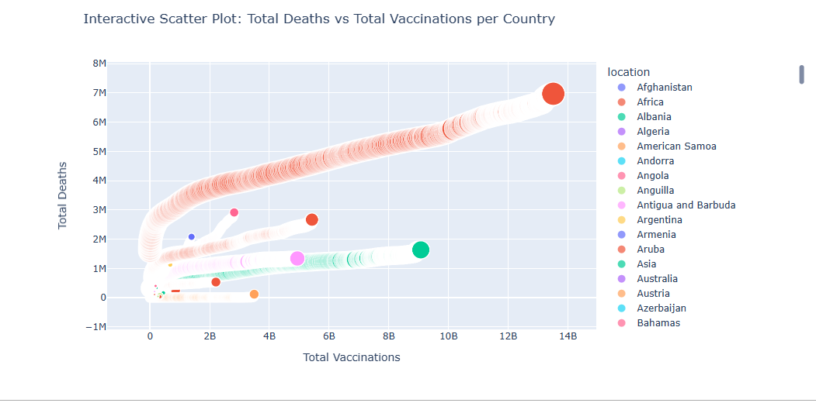

Slide 5
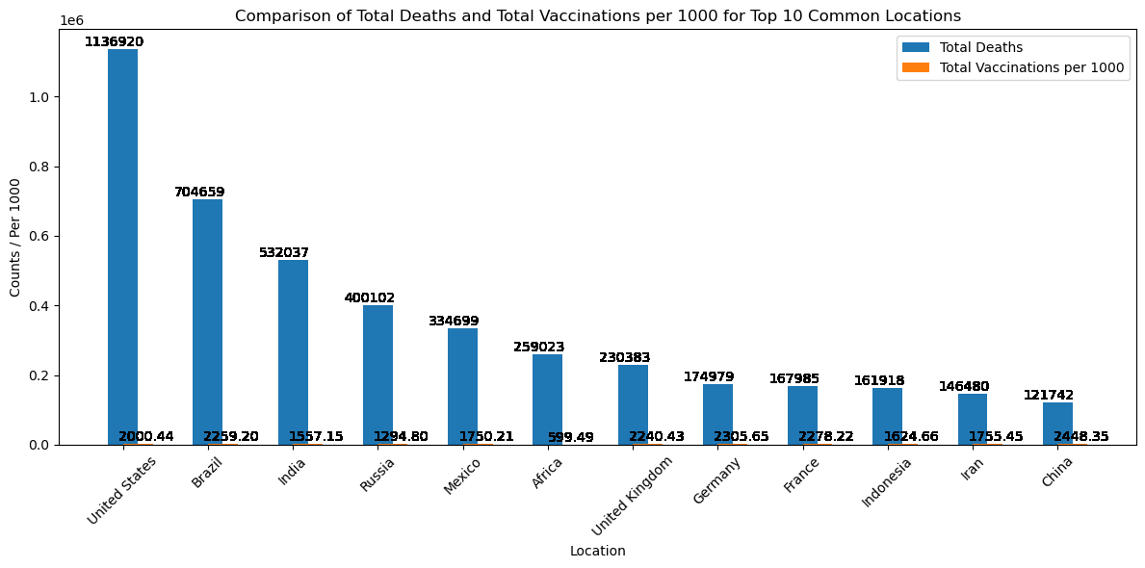

Slide 6
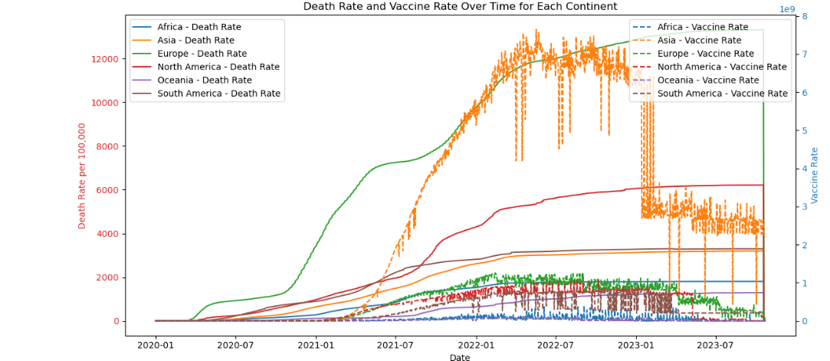

Slide 7
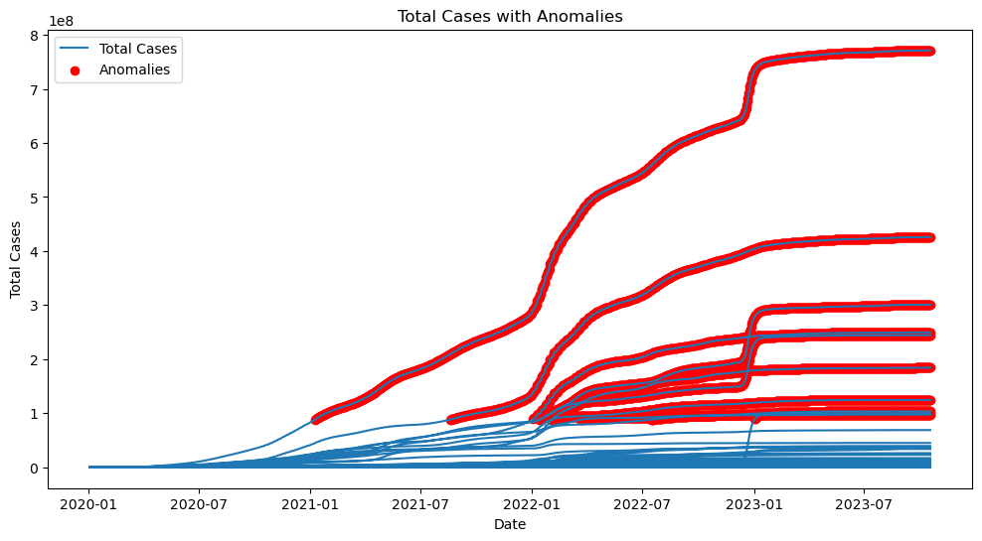
Evaluation
The data was processed well and the visualization was well implemented. I feel we could have been a bit more thorough with broadening our comparison on a more detailed time frame.
It does show over multiple graphs that there is a common trend. Showing that the beginning year of 2021 is where things spiked and the beginning year of
2023 is where things calmed down.

Slide 8
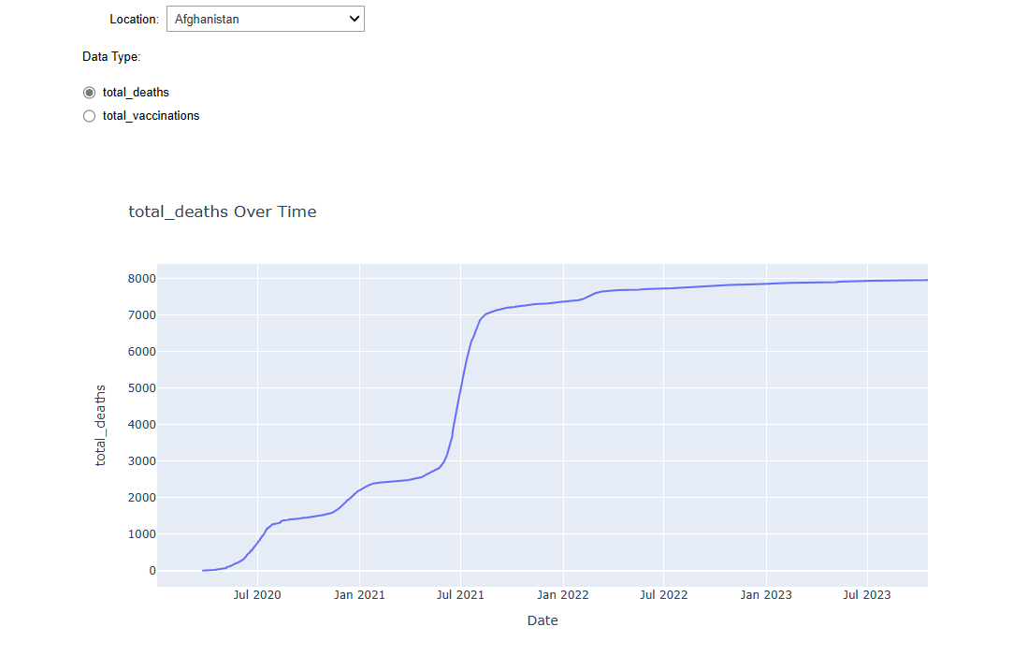
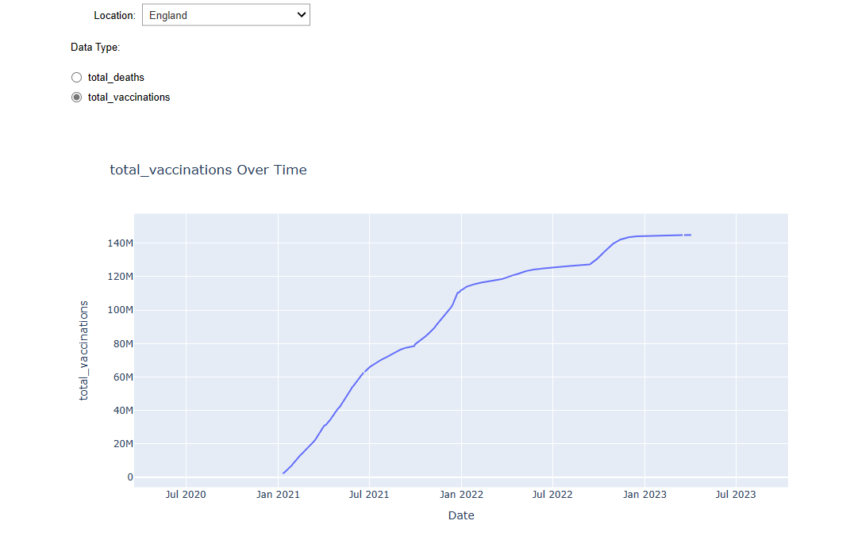
Comparisons
Region vs Global
Focusing on Vaccinations or Deaths solely compared to combination of the two to help find specific times and influential factors.
Data being limited or one-sided vs compared to multiple datasets being combined to one big dataset

Slide 9
Data
Top 10 Common Locations with Highest Deaths:
location total_deaths
0 United States 1136920.0
1 Brazil 704659.0
2 India 532037.0
3 Russia 400102.0
4 Mexico 334699.0
5 Africa 259023.0
6 United Kingdom 230383.0
7 Germany 174979.0
8 France 167985.0
9 Indonesia 161918.0
10 Iran 146480.0
11 China 121742.0
Top 10 Common Locations with Highest Vaccinations:
location total_vaccinations
0 China 3.491077
1 India 2.206747
2 Africa 8.553188
3 United States 6.767288
4 Brazil 4.864364
5 Indonesia 4.475958
6 Mexico 2.231590
7 Germany 1.922215
8 Russia 1.873745
9 Iran 1.554458
10 France 1.544933
The data was obtained from https://ourworldindata.org/covid-cases along with two other large dataset. Where they focus on confirmed Covid-19 cases/deaths globally and locally. From there a csv was downloaded with all the data collected and shared.
The dataset is around 87.62MB with 350049 records. With the focal point of the columns being "total_deaths," "total_vaccinations," "total_cases," and "population." Using the temporal data such as the years to cover 2020 to 2023.
Survey Program

